Slide 1
HOSPITAL MANAGEMENT SYSTEM
Made By:- Dhruvi Hiteshkumar Suthar
21162101005, cba, class-2a, sem-2, batch-21

Slide 2
Hospital Management System
This Hospital Management System includes the management of information of :
1. Patients
2. Staff
Doctors
Nurses
In this management system I have used the concept of Inheritance.

Slide 3
What is Inheritance?
The capability of a class to derive properties and characteristics from another class is called Inheritance. Inheritance is one of the most important features of Object-Oriented Programming.
Inheritance is a feature or a process in which, new classes are created from the existing classes. The new class created is called “derived class” or “child class” and the existing class is known as the “base class” or “parent class”. The derived class now is said to be inherited from the base class.

Slide 4
In this project I have used the concept of Hierarchical Inheritance.
In this type of inheritance, more than one subclass is inherited from a single base class. i.e. more than one derived class is created from a single base class.
Person
Staff
Doctors
Nurses
Patient
Classes I made are:
Person
Staff
Patient
Doctors
Nurses

Slide 5
Source Code
#include<iostream>
#include<string.h>
using namespace std;
class person
{
private:
char name[30], gender[7], city[20], state[20], bgroup[4];
int age, phone, id;
public:

Slide 6
void pinfo()
{
cout<<"\tEnter Name :";
cin>>name;
cout<<"\tEnter Gender :";
cin>>gender;
cout<<"\tEnter Age :";
cin>>age;
cout<<"\tEnter Address (city and state):";
cin>>city>>state;
cout<<"\tEnter Blood group:";
cin>>bgroup;
}
void displayinfo()
{
cout<<"Name: "<<name<<endl;
cout<<"Gender: "<<gender<<endl;
cout<<"Age: "<<age<<endl;
cout<<"Address: "<<city<<", "<<state<<endl;
cout<<"Blood Group:"<<bgroup<<endl;
}
};

Slide 7
class patient : public person
{
private:
int regno, bill, total;
char occ[30], date_admit[20], date_discharge[20], medicine[20];
public:
void getdata(); //function to accept data from user
void showdata(); //function to show data on screen
void pbill();
int pmenu();
};
void patient :: pbill() //using scope resolution operator to define function outside class
{
cout << "\n********************************************************************************";
cout << "\n\n\t\t\t\tPatient Fee Charge\n\n ";
cout << "*******************************************************************************";
cout << "\nHospital Room Charges :\t 1000";
cout << "\nHospital Care Charges :\t 50";
cout << "\nHospital Maintaince Charges :\t 50";
cout << "\nPatient Individual Charges :\t " << bill;
total = 1000 + 50 + 50 + bill;
cout << "\nTotal Fee Charge :\t" << total<<"\n";
cout << "********************************************************************************"<<endl;
}

Slide 8
void patient::getdata()
{
cout<<"---------------------------------------------------------------------------------"<<endl;
pinfo();
cout<<"\nEnter The registration number of the patient: ";
cin>>regno;
cout<<"\nEnter The occupation of the patient: ";
cin>>occ;
cout<<"\nEnter The bill of the patient:";
cin>>bill;
cout<<"\nEnter The date admitted(dd/mm/yyyy):";
cin>>date_admit;
cout<<"\nEnter The date discharged(dd/mm/yyyy):";
cin>>date_discharge;
cout<<"Enter prescribed medicine:";
cin>>medicine;
pbill();
}

Slide 9
void patient::showdata()
{
cout<<"---------------------------------------------------------------------------------"<<endl;
cout<<"\nRegistration number of patient: "<<regno<<"\n";
displayinfo();
cout<<"\nOccupation : "<<occ;
cout<<"\nAdmit date : "<<date_admit;
cout<<"\nDischarhge date :"<<date_discharge;
cout<<"\nBill :"<<total;
cout<<"\nPrescribed Medicine: "<<medicine<<endl;
}
int patient::pmenu()
{
char b;
do
{
cout<<"********************************************************************************"<<endl;
cout<<"\n--------------------------------------------------------------------------------"<<endl;
cout<<" PATIENT MENU "<<endl;
cout<<"---------------------------------------------------------------------------------"<<endl;
cout<<"\t1. Insert Patient Details"<<endl;
cout<<"\t2. Show Patient Details"<<endl;
cout<<"\t3. Exit Patient Menu"<<endl;
cout<<"\n\n\tPlease Select Your Option (1-3): ";
cin>>b;
cout<< "********************************************************************************"<<endl;

Slide 10
switch(b)
{
case '1':
getdata();
break;
case '2':
showdata();
break;
case '3':
return 0;
break;
default:
cout<<"\b";
}
}
while (b!='4');
}
class Staff:public person
{
private:
int salary;
char time_from[30],time_to[30];

Slide 11
public:
void staff_info()
{
pinfo();
cout<<"Enter salary:";
cin>>salary;
cout<<"Enter Duty time:"<<endl;
cout<<"From:";
cin>>time_from;
cout<<"To:";
cin>>time_to;
}
void show_staff()
{
cout<<"\nSalary: "<<salary;
cout<<"\nDuty Time: "<<time_from<<"--"<<time_to<<endl;
displayinfo();
}
};

Slide 12
class doctor : public Staff
{
private:
int docid;
char special[30];
public:
void docdata()
{
cout<<"---------------------------------------------------------------------------------"<<endl;
staff_info();
cout<<"Enter Doctor ID:";
cin>>docid;
cout<<"Enter Speciality :";
cin>>special;
}
void displaydocinfo()
{
cout<<"---------------------------------------------------------------------------------"<<endl;
cout<<"Doctor ID :"<<docid;
show_staff();
cout<<"\n"<<"Doctor Speciality :"<<special;
cout<<endl;
}

Slide 13
int docmenu()
{
char a;
do
{
cout<< "********************************************************************************"<<endl;
cout<<"---------------------------------------------------------------------------------"<<endl;
cout<<" DOCTOR MENU "<<endl;
cout<<"---------------------------------------------------------------------------------"<<endl;
cout<<"\t1. Insert Doctor Details"<<endl;
cout<<"\t2. Show Doctor Details"<<endl;
cout<<"\t3. Exit Doctor Menu"<<endl;
cout<<"\n\n\tPlease Select Your Option (1-3): ";
cin>>a;
cout<< "********************************************************************************"<<endl;
switch(a)
{
case '1':
docdata();
break;
case '2':
displaydocinfo();
break;
case '3':
return 0;
break;
default:
cout<<"\b";
}
}
while (a!='4');
}
};

Slide 14
class nurse : public Staff
{
private:
int nid;
int room;
public:
void ndata()
{
cout<<"---------------------------------------------------------------------------------"<<endl;
staff_info();
cout<<"Enter Nurse ID:";
cin>>nid;
cout<<"Enter the room number incharged :";
cin>>room;
}
void displayninfo()
{
cout<<"---------------------------------------------------------------------------------"<<endl;
cout<<"Nurse ID :"<<nid;
show_staff();
cout<<"\n"<<"The Room incharged to nurse :"<<room;
cout<<endl;
}

Slide 15
int nmenu()
{
char nu;
do
{
cout<< "********************************************************************************"<<endl;
cout<<"---------------------------------------------------------------------------------"<<endl;
cout<<" NURSE MENU "<<endl;
cout<<"---------------------------------------------------------------------------------"<<endl;
cout<<"\t1. Insert Nurse Details"<<endl;
cout<<"\t2. Show Nurse Details"<<endl;
cout<<"\t3. Exit Nurse Menu"<<endl;
cout<<"\n\n\tPlease Select Your Option (1-3): ";
cin>>nu;
cout<< "********************************************************************************"<<endl;
switch(nu)
{
case '1':
ndata();
break;
case '2':
displayninfo();
break;
case '3':
return 0;
break;
default:
cout<<"\b";
}
}
while (nu!='4');
}
};

Slide 16
class admin
{
private:
doctor d;
patient p;
nurse n;
public:
int staffmenu()
{
char ch;
do
{
cout<< "********************************************************************************"<<endl;
cout<<"---------------------------------------------------------------------------------"<<endl;
cout<<" STAFF MENU "<<endl;
cout<<"---------------------------------------------------------------------------------"<<endl;
cout<<"\t1. Doctor"<<endl;
cout<<"\t2. Nurse"<<endl;
cout<<"\t3. Patient"<<endl;
cout<<"\t4. Exit"<<endl;
cout<<"\n\n\tPlease Select Your Option (1-3): ";
cin>>ch;
cout<< "********************************************************************************"<<endl;

Slide 17
switch(ch)
{
case '1':
d.docmenu();
break;
case '2':
n.nmenu();
break;
case '3':
p.pmenu();
break;
case '4':
cout<<"Thank You!!"<<endl;
break;
return 0;
default:
cout<<"\b";
}
}
while (ch!='5');
}
};

Slide 18
int main()
{
admin ad;
char pass[15];
cout<<"********************************************************************************"<<endl;
cout<<"--------------------------------------------------------------------------------"<<endl;
cout<<"| HOSPITAL MANAGEMENT SYSTEM |"<<endl;
cout<<"| MADE BY - DHRUVI SUTHAR |"<<endl;
cout<<"| 21162101005 |"<<endl;
cout<<"---------------------------------------------------------------------------------"<<endl;
cout<<"\t\tTo enter ADMIN please enter password:";
cin>>pass;
cout<< "********************************************************************************"<<endl;
if(strcmp(pass,"admin")==0)
{
ad.staffmenu();
}
else
{
cout<<"WRONG PASSWORD!!"<<endl;
}
return 0;
}

Slide 19
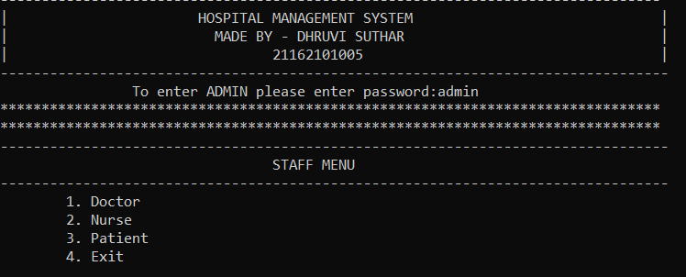
To open STAFF MENU

Slide 20
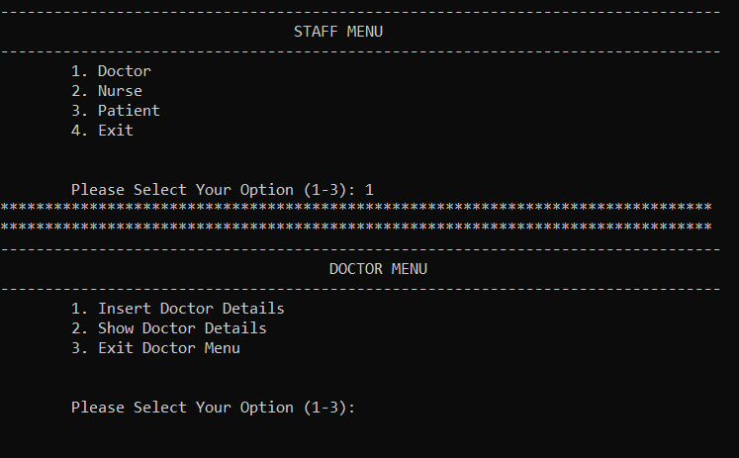
To open Doctor Menu

Slide 21
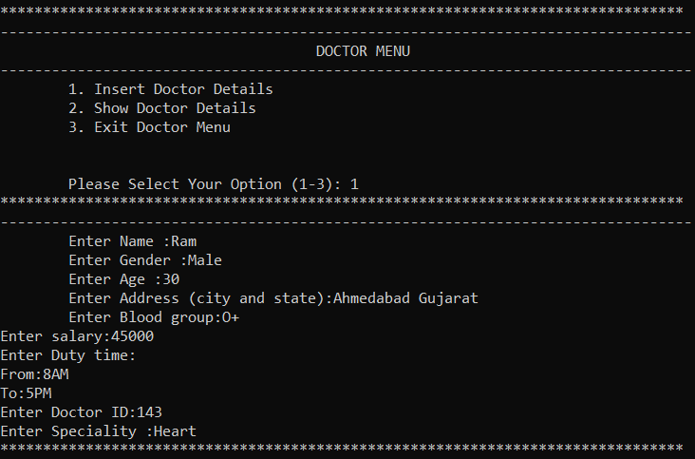
To add Doctor Details

Slide 22
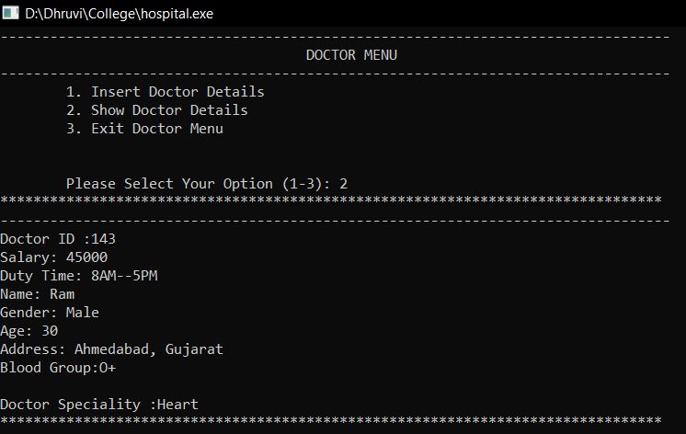
To show doctor details

Slide 23
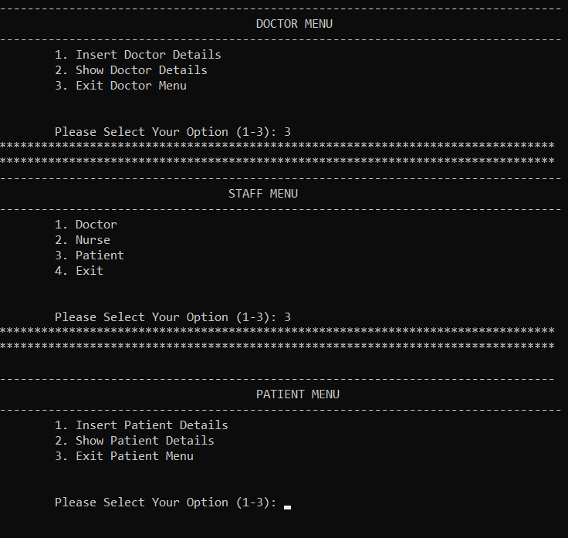
To open Patient Menu

Slide 24
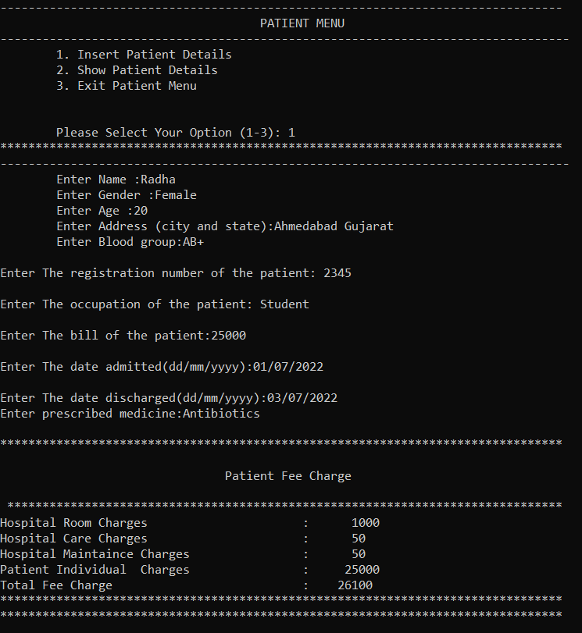
To add patient details

Slide 25
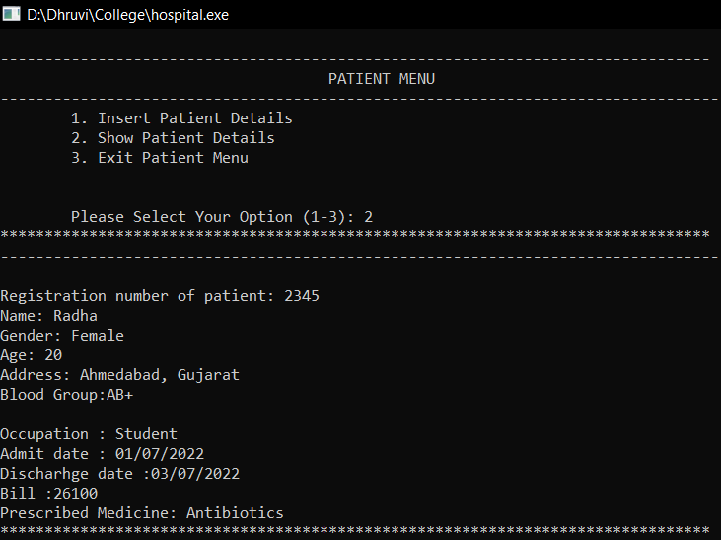
To show patient data

Slide 26
Thank You.

